Slide 1

2020 KBO MVP Prediction

Slide 2
Index
Motivation
Crawling
Data Preprocessing
Machine Learning
Conclusion

Slide 3


Motivation

Slide 4
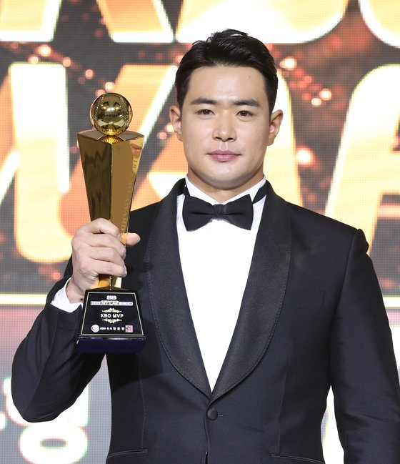

MVP
2018 MVP
김재환
2019 MVP
린드블럼

Slide 5
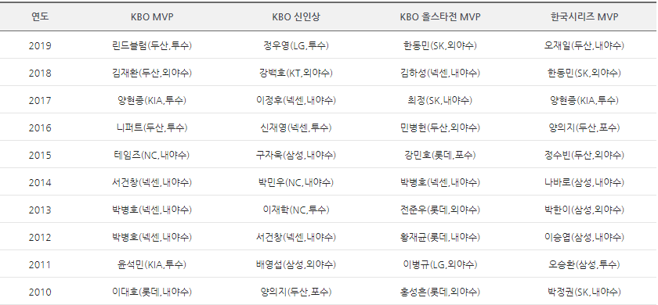
MVP

Slide 6
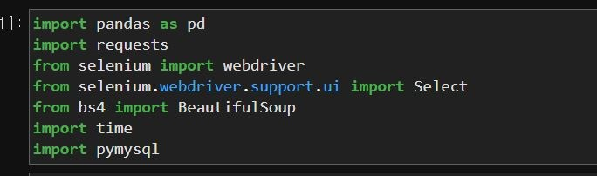
Crawling

Slide 7
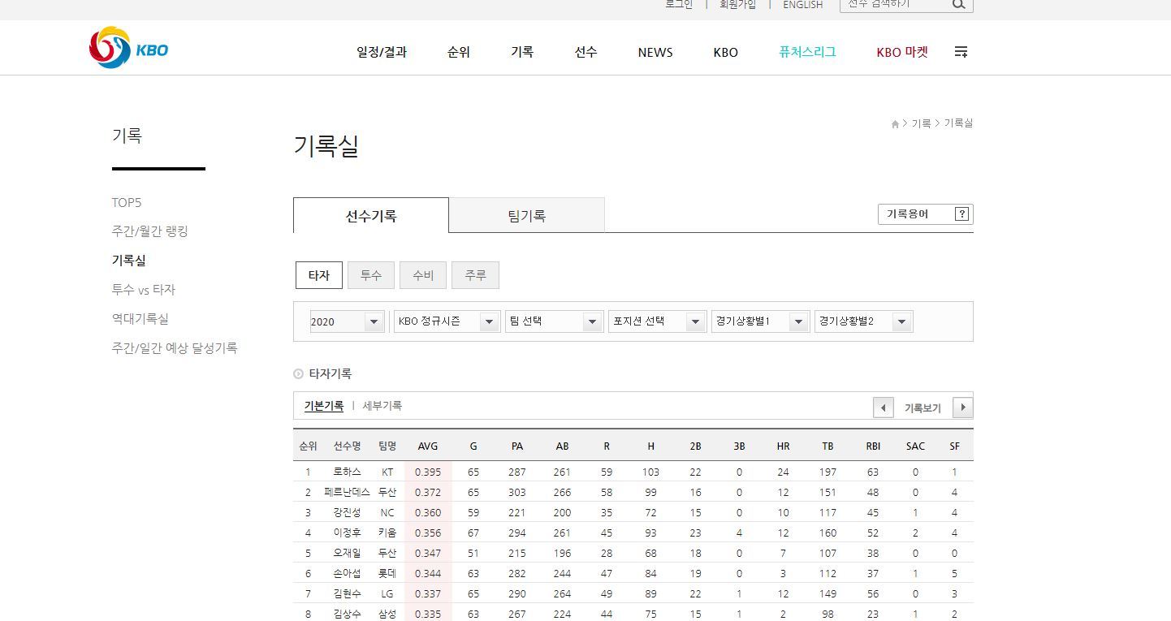
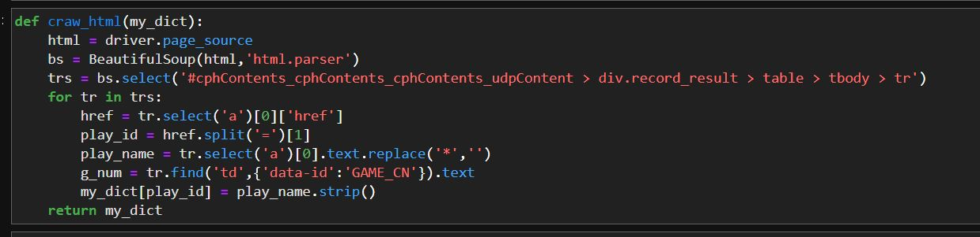
Crawling

Slide 8
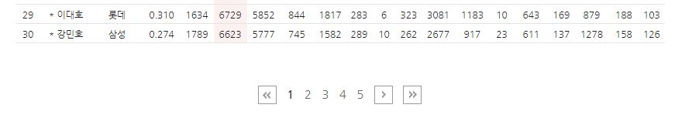
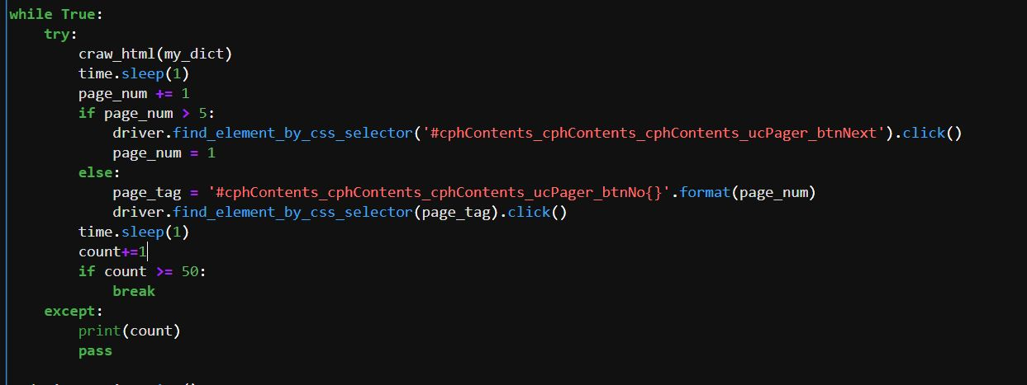
크롤링(Crawling)
Crawling

Slide 9
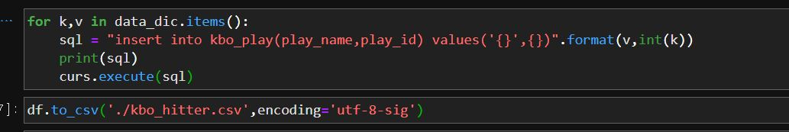
Crawling

Slide 10
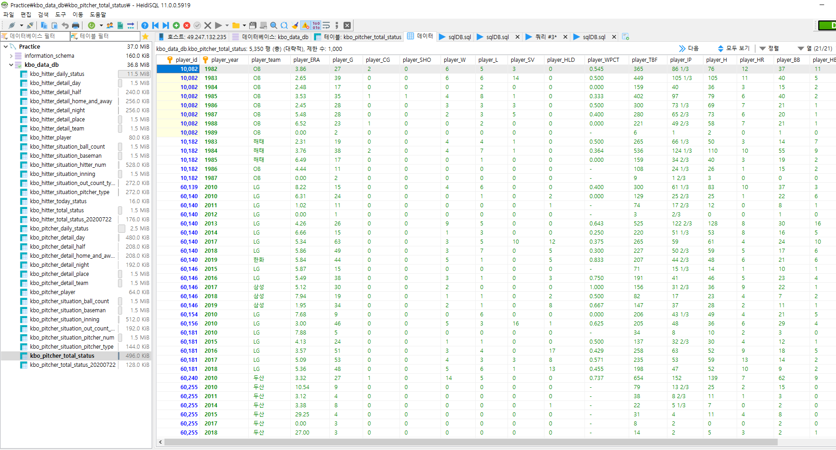
Crawling

Slide 11
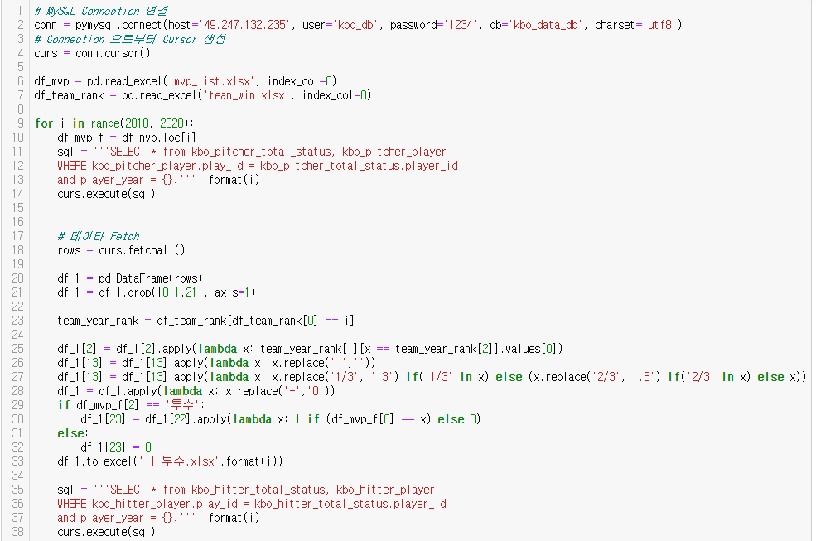
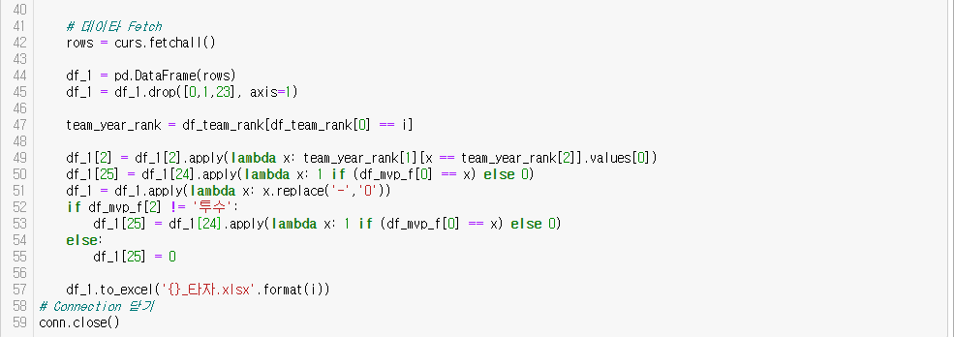
Data Preprocessing

Slide 12
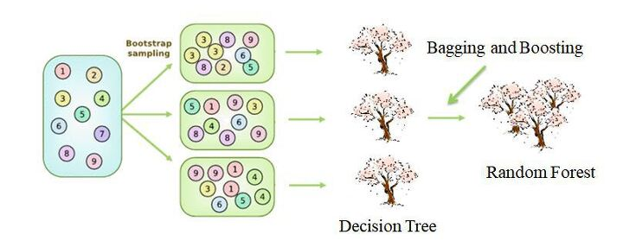
Machine Learning

Slide 13
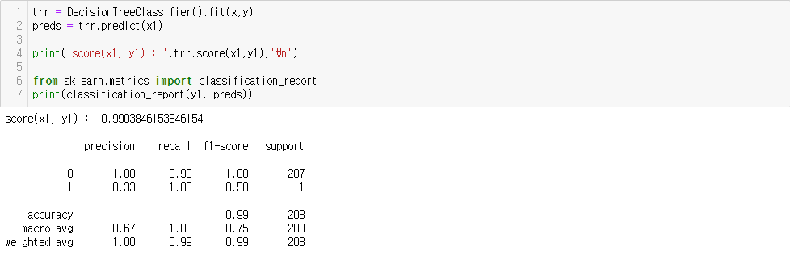
Machine Learning

Slide 14
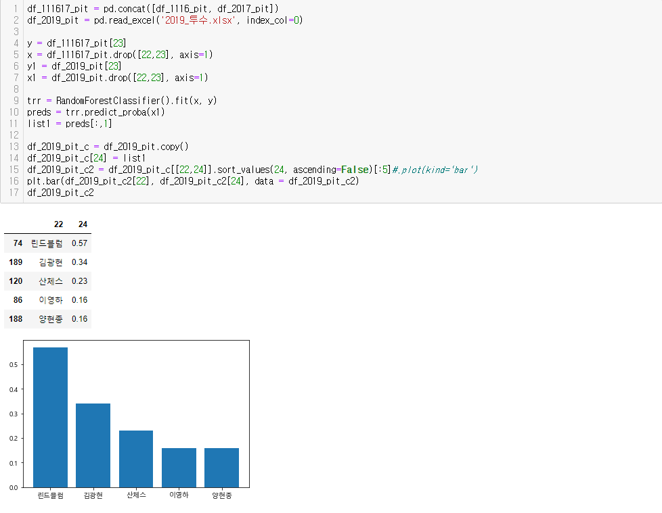
Machine Learning

Slide 15
Conclusion

Slide 16
감사합니다!

